Slide 1

Data-driven Visual Similarity for Cross-domain Image Matching
Abhinav Shrivastava, Tomasz Malisiewicz,
Abhinav Gupta and Alexei A. Efros
Carnegie Mellon University

Slide 2
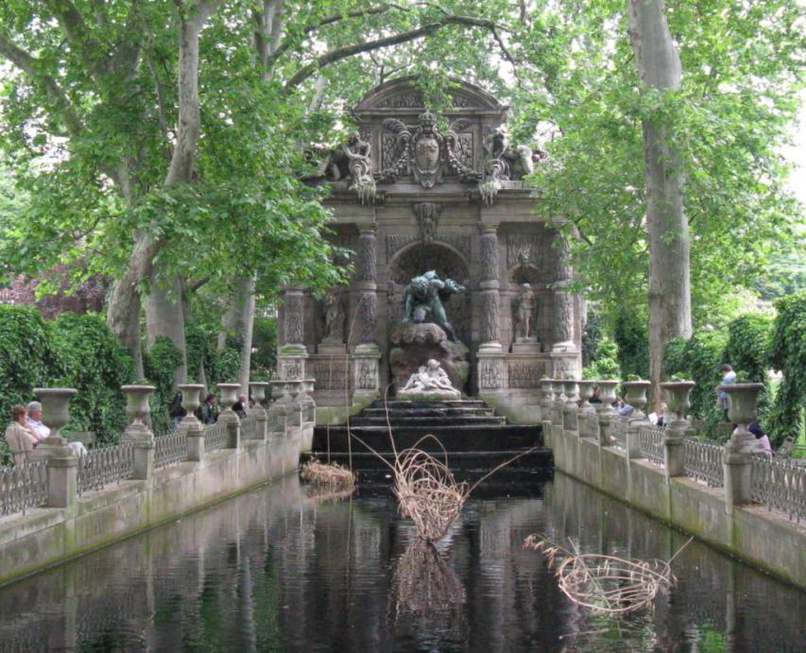
Medici Fountain, Paris
Notes:
This is a photograph taken by my advisor of Medici fountain from Paris..
I really liked this photograph and wanted to find some similar images!
I thought of using Google’s recently launched Search-by-Image feature.. I took this image..

Slide 3

Notes:
Dropped it in google image search; It searches thru billions of images
And magically returns these matches..

Slide 4
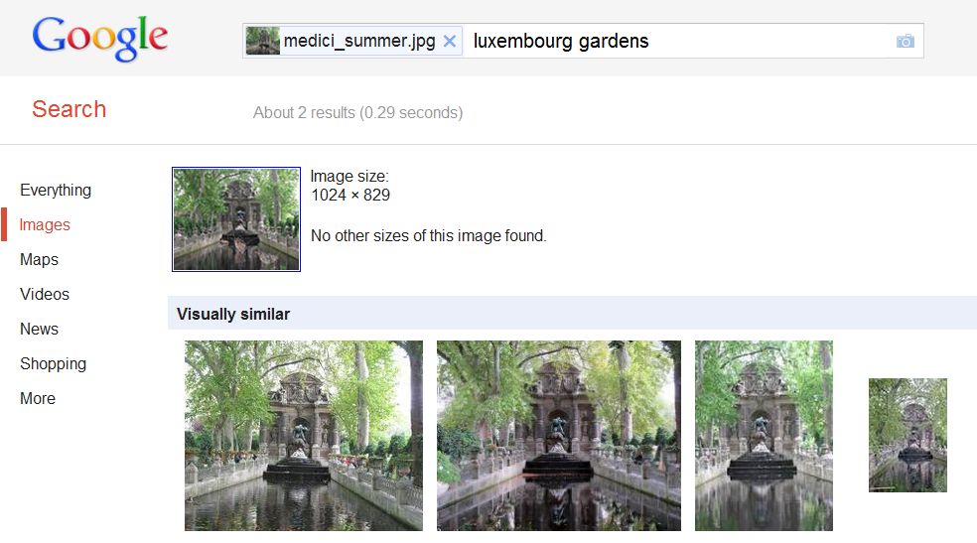
Notes:
Which look pretty good!
Great I thought!
How about this image?

Slide 5
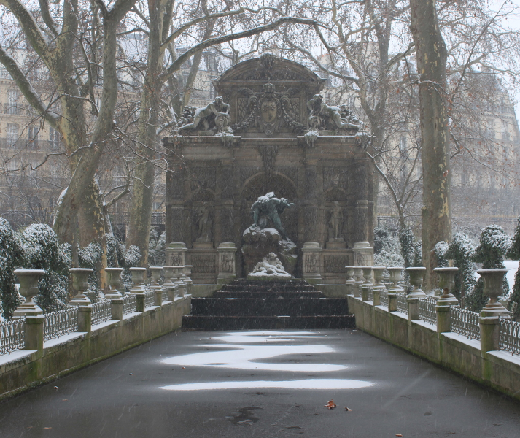
Medici Fountain, Paris (winter)
Notes:
Of the same place, the medici fountain..
Just from a different season.

Slide 6
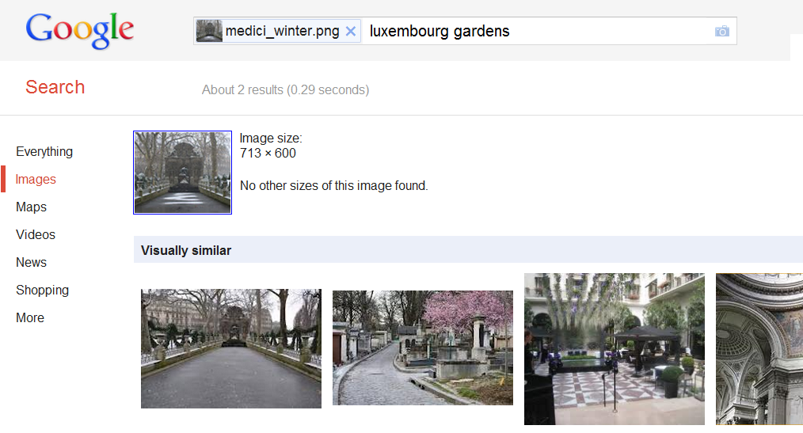
Notes:
These are the top matches by google..
The first match looks reasonable, but others are not as good..
Why so?
One explanation can be that it rarely snows in Paris. So images with snow at medici fountain are rare.. Ok..

Slide 7
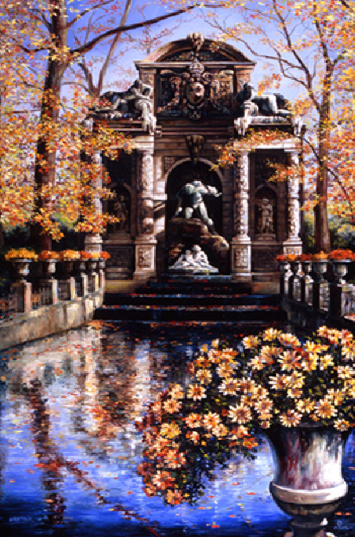
Notes:
What if I want to use this painting OF THE SAME PLACE, the medici fountain, to find similar images

Slide 8
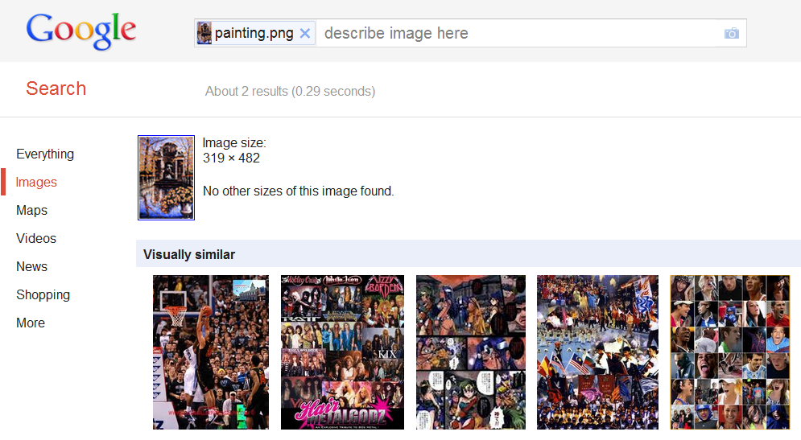
Notes:
The results are even worse…

Slide 9
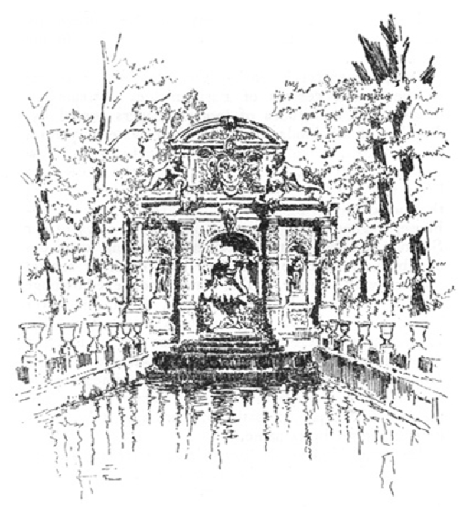
Notes:
What abt this sketch,
again of the same place medici fountain..

Slide 10
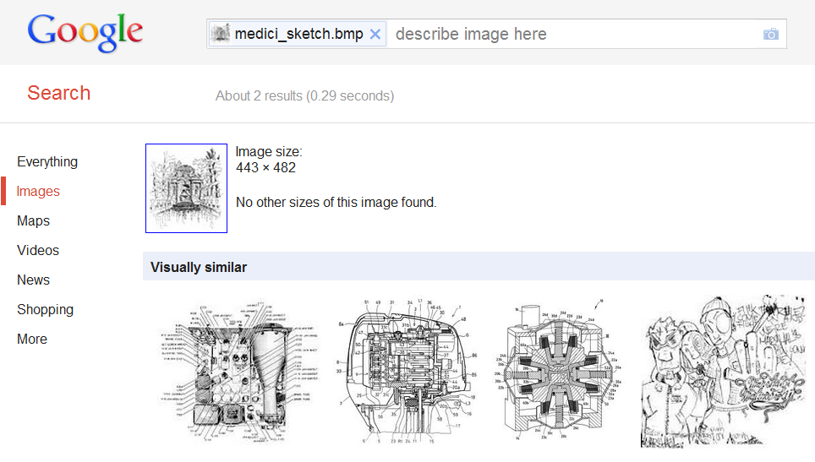
Notes:
No luck again…
In this work..

Slide 11
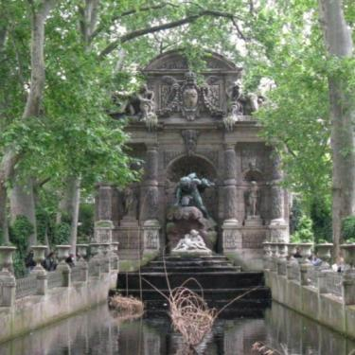
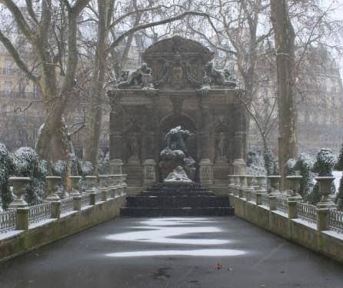


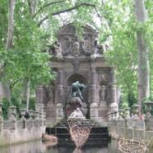
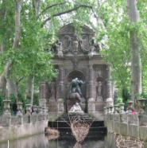
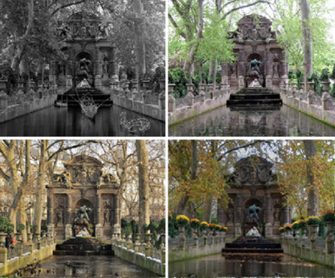
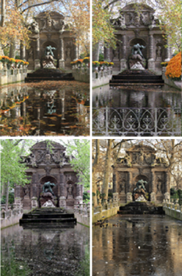
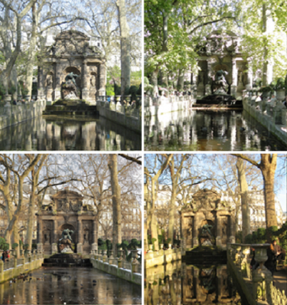
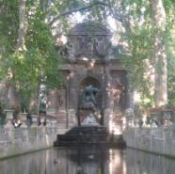
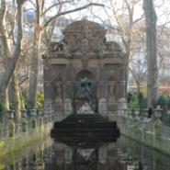
Our Goal
Notes:
In this work,
We propose a way to match images
Invariant to visual variations such as different seasons and even visual domains such as paintings or sketches.

Slide 12
Why is this so Hard?
Notes:
Visual appearance – different @ Raw pixel level
In the Past decade,

Slide 13
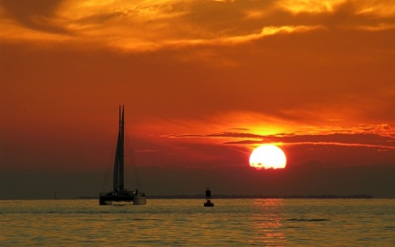
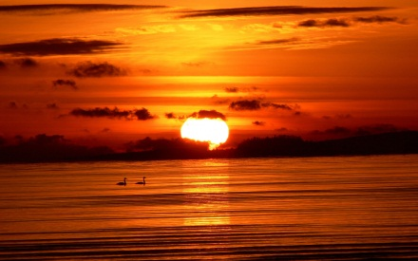
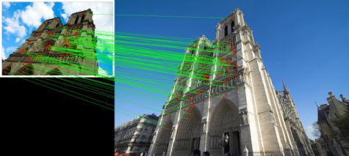
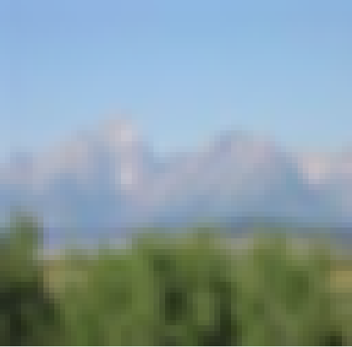
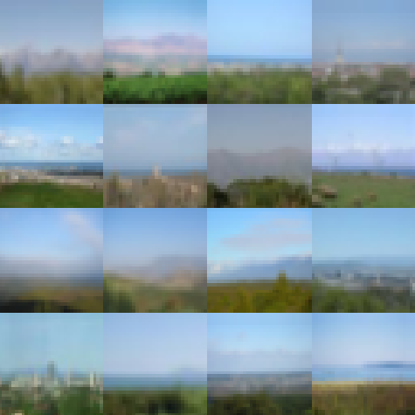
Image Retrieval
Color-histograms
  QBIC [Flickner et al., 1995]
  Pentland et al., 1996
  …
SIFT-based approaches
  Lowe, 1999, 2004
  Sivic and Zisserman, 2003
  Chum et al., 2007-10
  Jegou et al., 2008-10
  Lazebnik et al., 2009
  …
Gist-based approaches
  Oliva and Torralba, 2006
  Hays and Efros, 2007
  Weiss et al., 2007
  Torralba et al., 2008
  …
Notes:
There has been lot of work in the field of image retrieval..
Starting from simple color-histogram based techniques to approaches that use SIFT and GIST descriptors..
But these usually work well

Slide 14
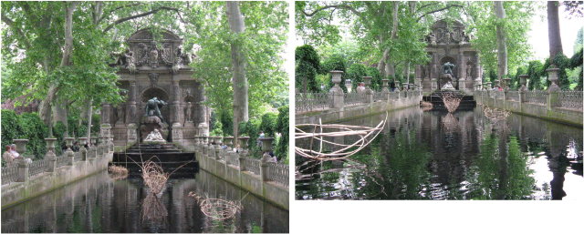
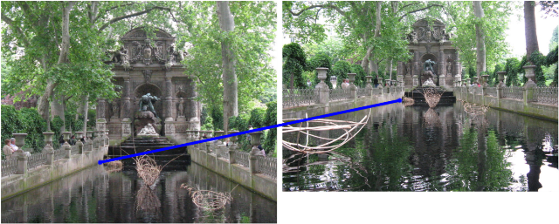
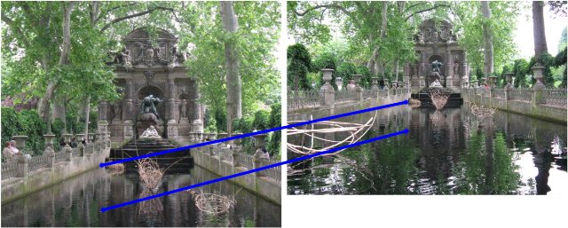
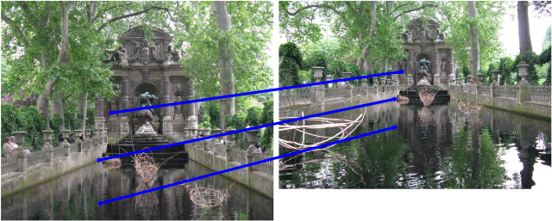
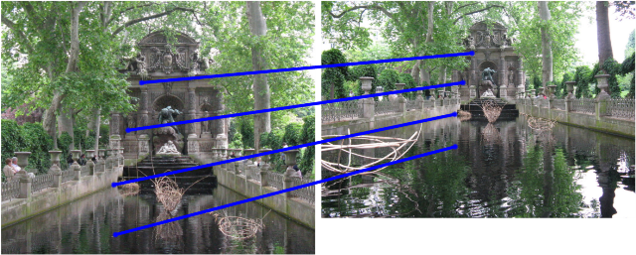
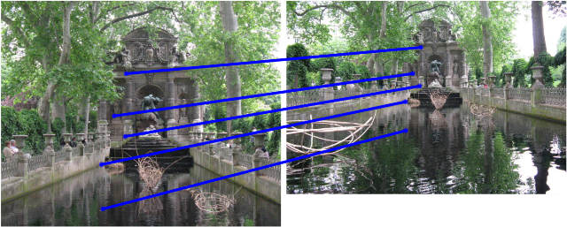
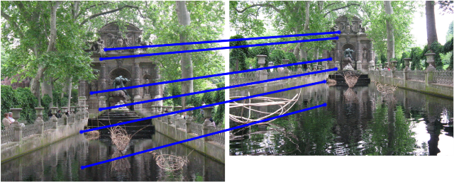
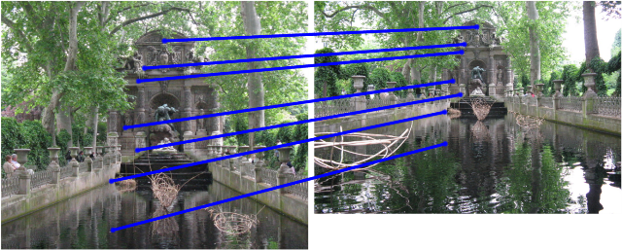
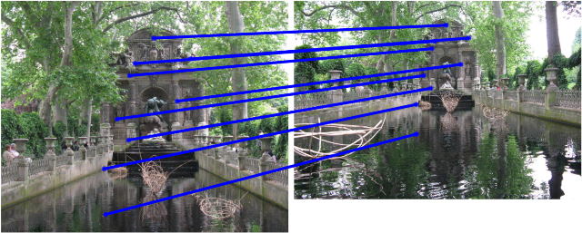
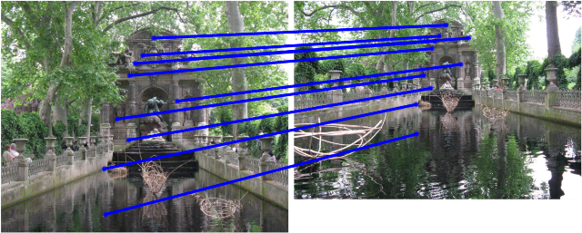
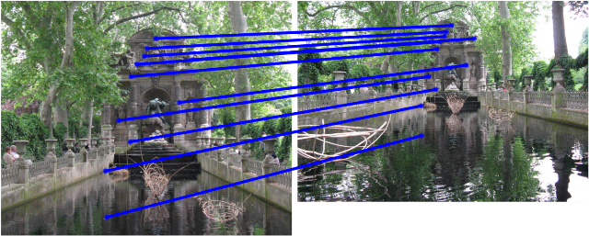
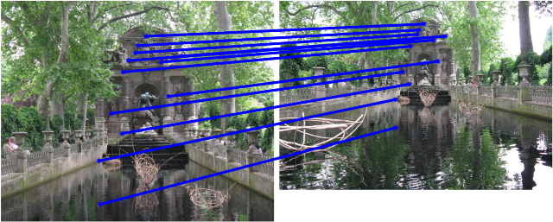
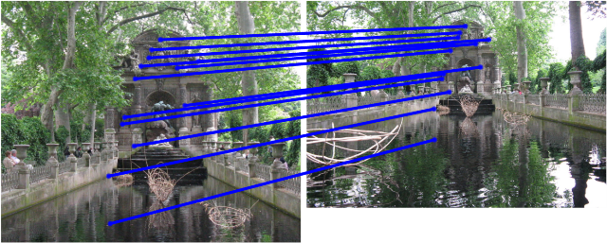
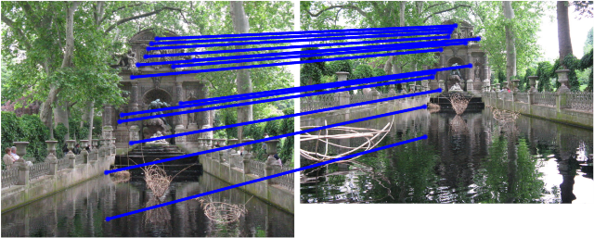
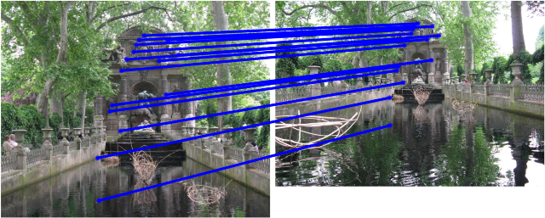
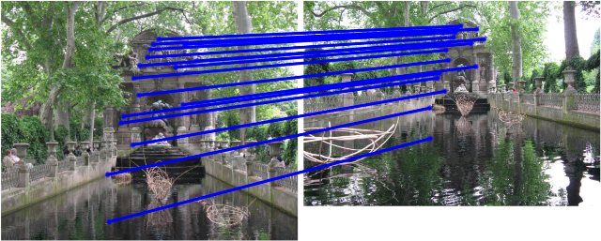
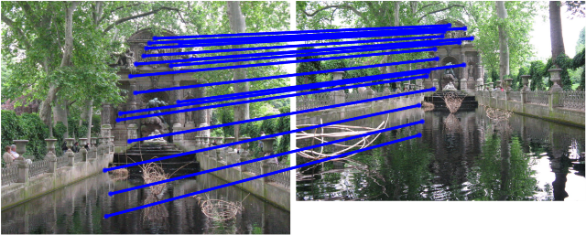
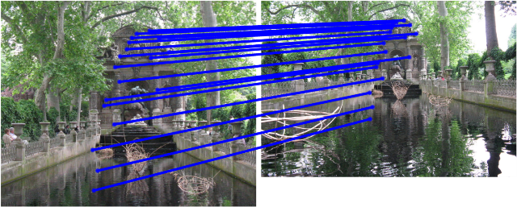
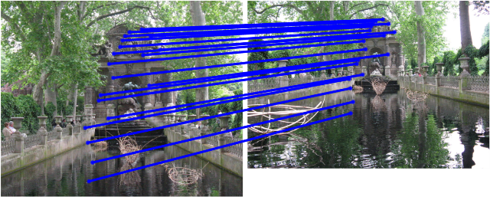
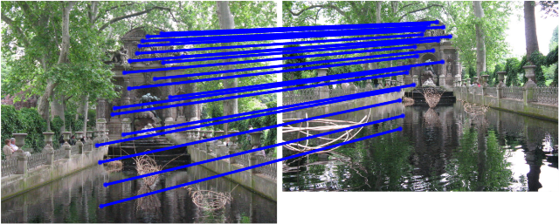

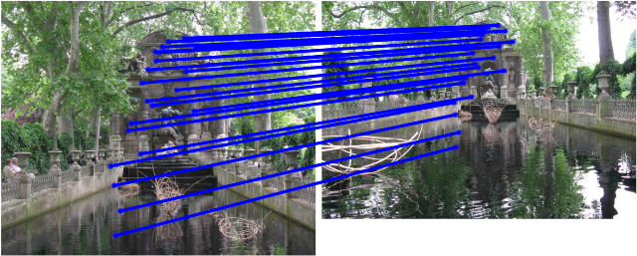

Example: SIFT Matching
[SIFT: Lowe, 2004]
Notes:
If the images are very similar to begin with..
For example,
To matching these 2 image from medici fountain
Popular SIFT desc Works really well..
But

Slide 15
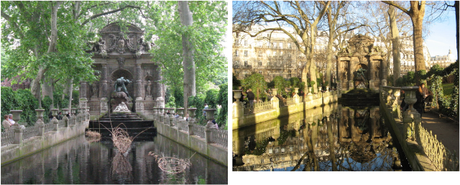
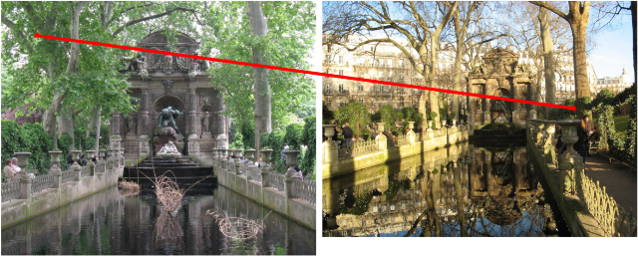
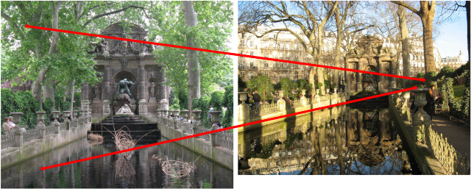
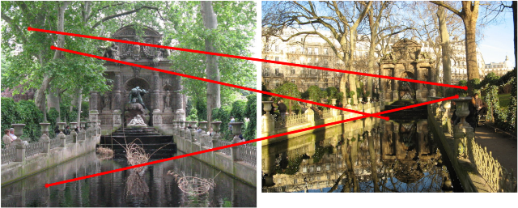
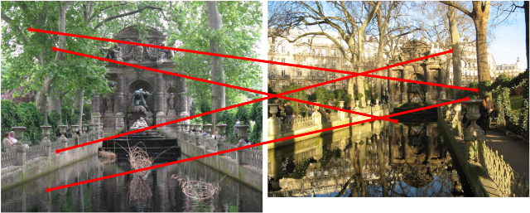
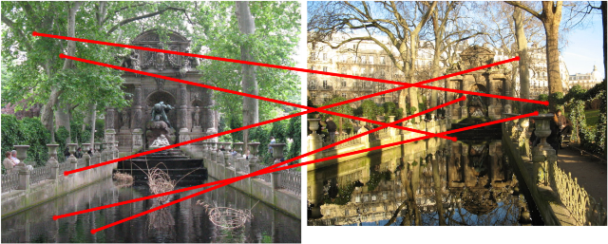
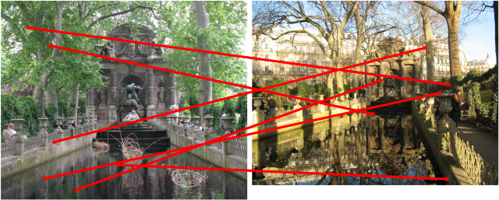














Example: SIFT Matching
[SIFT: Lowe, 2004]
Notes:
In case of these images of the exact same place, the medici fountain, just from a different season,
It fails miserably.
To handle this visual variations, different representations have been proposed before catering to specific domains.

Slide 16





Cross-domain Matching
Sketch to Photo
    Kato et al., 1992
    Liang et al., 2004
    Chen et al., 2009
    Eitz et al, 2010
    …
Painting to Photo
    Hirata et al., 1992
    Russell et al., 2011
    …
Domain-invariant
    Shechtman and Irani, 2007
    Boiman and Irani, 2006
    …
Notes:
Techniques that
use hand drawn sketches and textual annotations to find similar images
use 3D model from images to align paintings
Finally the most relevant 2 our work is the research on domain invariant representations -- Local self-similarity descriptors.
But we believe that the problem is bigger than representation.

Slide 17

Notes:
Given this illustration, we want to find matching images from a *very large dataset*
Gradient based matching approach.

Slide 18





Input Query
Top Matches

Slide 19
Input Query
Top Matches

Slide 20
Input Query
Top Matches
Notes:
EVEN WORSE
But these are actually good matches for the computer because they do match something; just that these are not the matches that we humans want when we query this image.
It is that temple that we want to find, not the sky.
It is the temple that is important for humans to match in this image… But a computer has no way of knowing which are the important parts to match..

Slide 21

Important Parts?
Input Query
Important Parts
Notes:
What if an oracle marked important parts for us?
Then we can down-weigh the non important parts in this image while matching and retrieving images..

Slide 22


Top Matches
Input Query
Notes:
Using same feature, these retrievals.. Present in the dataset
How do we find the interesting bits..

Slide 23

“Data-driven Uniqueness”
Notes:
We hypothesis that the things that are unique in this image are the things that do not occur freq in a large set of images. For example, the sky in this painting is not that unique because it occurs everywhere; however, it is the temple, that is less frequent, that is unique about this image. It is the temple that *separates* this image from this large set of natural world images. This is what we call “Data-driven Uniqueness”.
What we want is a separating boundary that separates this one image from this entire world of images. How we do it? Standard SVM machinery from ML – helps us find out what makes this different
Distance from this separating boundary gives us a rank ordering on all the images in the retrieval set and the top images are our top matches.
RANK images..

Slide 24




















Notes:
DATA-Driven uniqueness..
Lets look under the hood to see how SVM does this magic..

Slide 25

What is Unique?
Notes:
Simple synthetic example. Image of triangle and rectangle
Don’t know what is unique coz we don’t know how the world of images looks like.

Slide 26













What is Unique given this World?
World of Images
Notes:
How can computer figure this out?
Our idea is to use Support Vector Machine..
In a standard setting,

Slide 27










Support Vector Machine (SVM)
Class A
Class B
W₁
[Cortes and Vapnik, Machine Learning, 1995]
Notes:
In a standard setting, SVM is used classification, as a
Discriminative classifier which tells us which features in class A make it different from class B.

Slide 28





Per-Exemplar SVM
World of Images
Image₁
W₁
W₂
Image₂
[Malisiewicz et al., ICCV, 2011]
Notes:
What if I had a single image instead of class A?
How the single image is different from class B?

Slide 29




Feature Representation
Histogram of Oriented Gradients (HOG)
[Dalal and Triggs, CVPR, 2005]

Slide 30



















Visualizing Uniqueness
Query
Before
After
World of Images
Notes:
HOG before and after (refer to the paper)

Slide 31





HOG
Top Match
Input Query
Learnt Weights
Top Match
Notes:
Let us use this leant uniqueness….
(refer to the paper)

Slide 32





Search using Images
Input Query
Top Matches

Slide 33
Search using Images
Input Query
Top Matches
Notes:
We use efficient sliding window search technique that allows us to find best matching sub-images to the given query image.

Slide 34
Search using Images
Input Query
Top Matches
Notes:
For clarity of presentation, we will use cropped sub-images for the entire presentation.

Slide 35




Search using Paintings
GIST
Input Painting
Bag-of-Words
Tiny Images
Our Approach
HOG
Notes:
Various baseline representations (refer to the paper)

Slide 36


Search using Paintings
Input Painting
Top Matches

Slide 37


Search using Paintings
Input Painting
Top Matches

Slide 38




Search using Sketches
Tiny Images
Input Sketch
GIST
Bag-of-Words
Our Approach
HOG
Notes:
(refer to the paper)

Slide 39




Search using Sketches

Slide 40




Search using Sketches

Slide 41
Quantitative Evaluations
Notes:
Difficult to do quantitative evals for retrieval tasks.
We evaluate on 2 different retrieval tasks…

Slide 42
Image Instance Retrieval
Holidays Dataset [Jegou et al., 2008]
#Query Images: 500 Photographs
#Retrieval Set Images ~ 1M Flickr Images

Slide 43

Image Instance Retrieval
Holidays Dataset
Mean true positive rate of the top-5 image matches as a function of dataset size
Notes:
This table represents the % of true positives for each query in the top-5 retrieved images.
We start with only images from Holidays dataset (in column 1)
And go on to add 1M distractors from flickr (shown in the last column).
Note that our algorithm does consistently better than the baselines and the performance does not drop drastically even after adding 1M distractors..

Slide 44
Sketch-based Image Retrieval
Query Sketches:
25 Car & 25 Bicycle Sketches
Retrieval Set:
10,000 Annotated Images
Pascal VOC 2007 Dataset
[Everingham et al., 2008]
Notes:
For the retrieval set, we need annotated images for evaluation.
So we use 10,000 annotated images from pascal.

Slide 45


Sketch-based Image Retrieval
mAP for Car Sketches
mAP for Bicycle Sketches
Notes:
These graphs show mean average precision for top 150 images retrieved.
The point on the left on both graphs represent only using true positive images and the points on extreme right represent using the full dataset..
I built the motivation by saying that the weights that we learn represents what we as humans are interested in finding. So, it is natural to compare how approach relates to saliency.

Slide 46


Saliency
[Yarbus, 1962]
Notes:
saliency for an image is defined as what do people look at in an image.. We tried to use the weights learned by our algorithm as a proxy for saliency..

Slide 47


Proxy for Saliency
Notes:
For example, given this image. We learn the unique weights, and using a simple heuristic this is our proxy saliency map. Where brighter reagions are more salient..
We also evaluated

Slide 48

Predicting Saliency
Saliency Dataset [Judd et al., 2009]
Notes:
We also evaluated our approach on a Standard saliency dataset by judd et al. and compare against standard approaches catered for predicting saliency.
Our to state of the art.
Red circle.. That were designed specifically for predicting saliency..
We are slightly worse than state of the are..
We are way better than the classic approach of itti et al.

Slide 49





Where does it fail?
Top Matches
Notes:
Of course, there are cases where it fails…
This is a typical example of failure of our approach where nothing stands out..

Slide 50
Applications
Notes:
This new way of matching
we proposed enables us to
demonstrate some new and cool
Data-driven applications..
Consider for example..

Slide 51


Re-photography
Computational Re-photography
(Bae et al., 2010)
Historical Image of
Boston Station
Re-photographed Image
Notes:
Goal of Rephotography is given a historical image like this,
Rephotograph the same place and have a then and now view..
This technique of going on location and doing repeat photography is quite popular.
Bae et al in their paper Computational rePhotography suggest techniques to assist users with on-location camera settings for rephotography.

Slide 52

Re-photography
Computational Re-photography (Bae et al., 2010)
Historical Image of
Boston Station
Re-photographed Image
Then & Now View

Slide 53

Internet Re-photography
Computational Re-photography (Bae et al., 2010)
Historical Image of
Boston Station
Re-photographed Image
Then & Now View
Our Approach
Search
10,000 Flickr Images
of Boston
Historical Image of
Boston Station
Top Match
Notes:
However, we believe why do we need to go to that place, boston to rephotograph and have a then and now view.
10000ss of people already going there ……

Slide 54

Internet Re-photography
Computational Re-photography (Bae et al., 2010)
Historical Image of
Boston Station
Re-photographed Image
Then & Now View
Our Approach
Historical Image of
Boston Station
Top Match
From 10,000 Flickr Images
Then & Now View

Slide 55

Internet Re-photography
Paris (1940)
Notes:
(refer to the paper)

Slide 56

Internet Re-photography
Paris (1940)
Top Matches

Slide 57

Internet Re-photography

Slide 58


Where was the Painter Standing?
Input Painting
Notes:
Where was the painter standing? When he was drawing this painting of tower bridge in london?

Slide 59
Painting2GPS
Input Painting
Retrieval set
10,000 Geo-tagged Flickr Images
100 top matches used to estimation
Notes:
Well, now we can find that! And we call this application …..
These are the guesses..
# of flickr images with GPS coordinattes

Slide 60

Painting2GPS
Input Painting
Estimated Geo-location
Estimated using 100 top matches
Notes:
These are the guesses..
# of flickr images with GPS coordinattes

Slide 61

Painting2GPS
Notes:
(refer to the paper)
In case video doesn’t work, embed video from ./video/paint2gpsNew.wmv

Slide 62
Visual Scene Exploration
Notes:
Organize and Explore photos taken by different people on internet
Download

Slide 63

Visual Scene Exploration
Notes:
Download a bunch of 200 images and try to organize them.
This is not something new, even photosynth tries to do that. It tries to organize all photographs with a coherent 3D model.

Slide 64



Photosynth
[Snavely et al., 2006]
Synth 1
Synth 2
Synth 3 ……
Dataset size: 136 photos (from flickr)
# of discovered synths: 14
82 photos not part of any synth
Notes:
It splits all images of the same place into 14 synths.. And more than 60% of images do not belong to any synth..
So what do we do?
More details on http://photosynth.net/view.aspx?cid=b3d45adf-202c-4b6a-a2da-0dcbdef88901
Misc: Photosynth explorations of Medici fountain images. Images were downloaded from flickr using "medici fountain paris". Given the entire set of 250 images, photosynth wasn't able to create the synths. Therefore, the set was cleaned to remove all the distractros i.e. image not of medici fountain. So the set contains only images of Medici Fountain. So it was a best case scenario for making synth.

Slide 65








Finding Similar Images
Query image
Notes:
This NN, for all images from the set we downloaded..
(refer to paper for details)

Slide 66






Pairwise Similarity Matrix
. . . . . .
…
. . . . . .
. . . . .
…

Slide 67

Pairwise Similarity Matrix
. . . . . .
…
. . . . . .
. . . . .
…
Tomasz Malisiewicz et al., 2009
Notes:
We can do some cool things like traverse nearest neighbour, find shortest path between graphs. Also starting from an image, we can just traverse the entire graph..

Slide 68










Traversing the Graph
Notes:
We can traverse different scales and seasons as well! (refer to paper for details)

Slide 69
Conclusion
Good News:
  Results surprisingly nice
Bad News:
  Computationally expensive
Notes:
Data-driven uniqueness
Used to produce robust similarity metric
That can be used for image retrieval even across domains.
Not fit for real-time retrieval system // not a fast process,
Ways to make this faster

Slide 70
Conclusion
Website:
http://graphics.cs.cmu.edu/projects/crossDomainMatching/
Code: https://github.com/quantombone/exemplarsvm

Slide 71

Thank You!
Notes:
In case video doesn’t work, embed video from ./video/mediciTraversal.wmv

Slide 72
Backup Slides…

Slide 73

Image (Instance) Matching on
Holidays Dataset
Notes:
1 mill, top 100 62%

Slide 74

All SIFT Matches

Slide 75

All SIFT Matches

