Slide 1
Intro to Deep Learning
Slides Credit: Andrej Karapathy, Derek Hoiem, Marc Aurelio, Yann LeCunn

Slide 2
Why this class?

Slide 7
Deep Features
Have been able to harness the big data in the most efficient and effective manner.
Lead to several state of the art results!

Slide 9
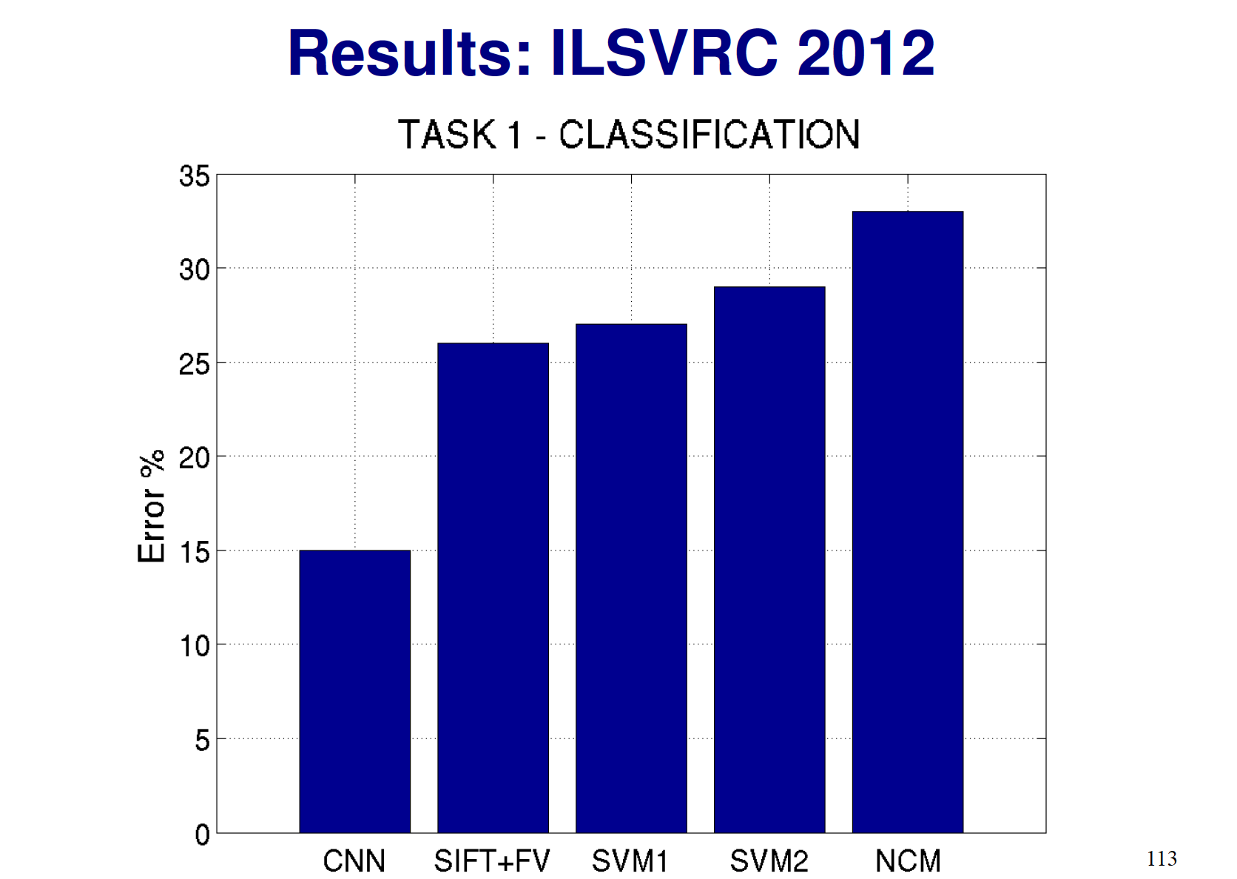
2014 Performance: 6.5% Error

Slide 14
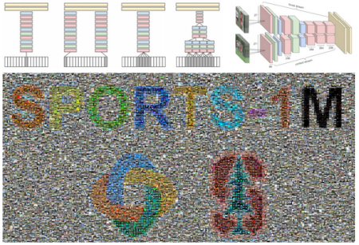

Slide 15
What is deep learning? - tutorial

Slide 20
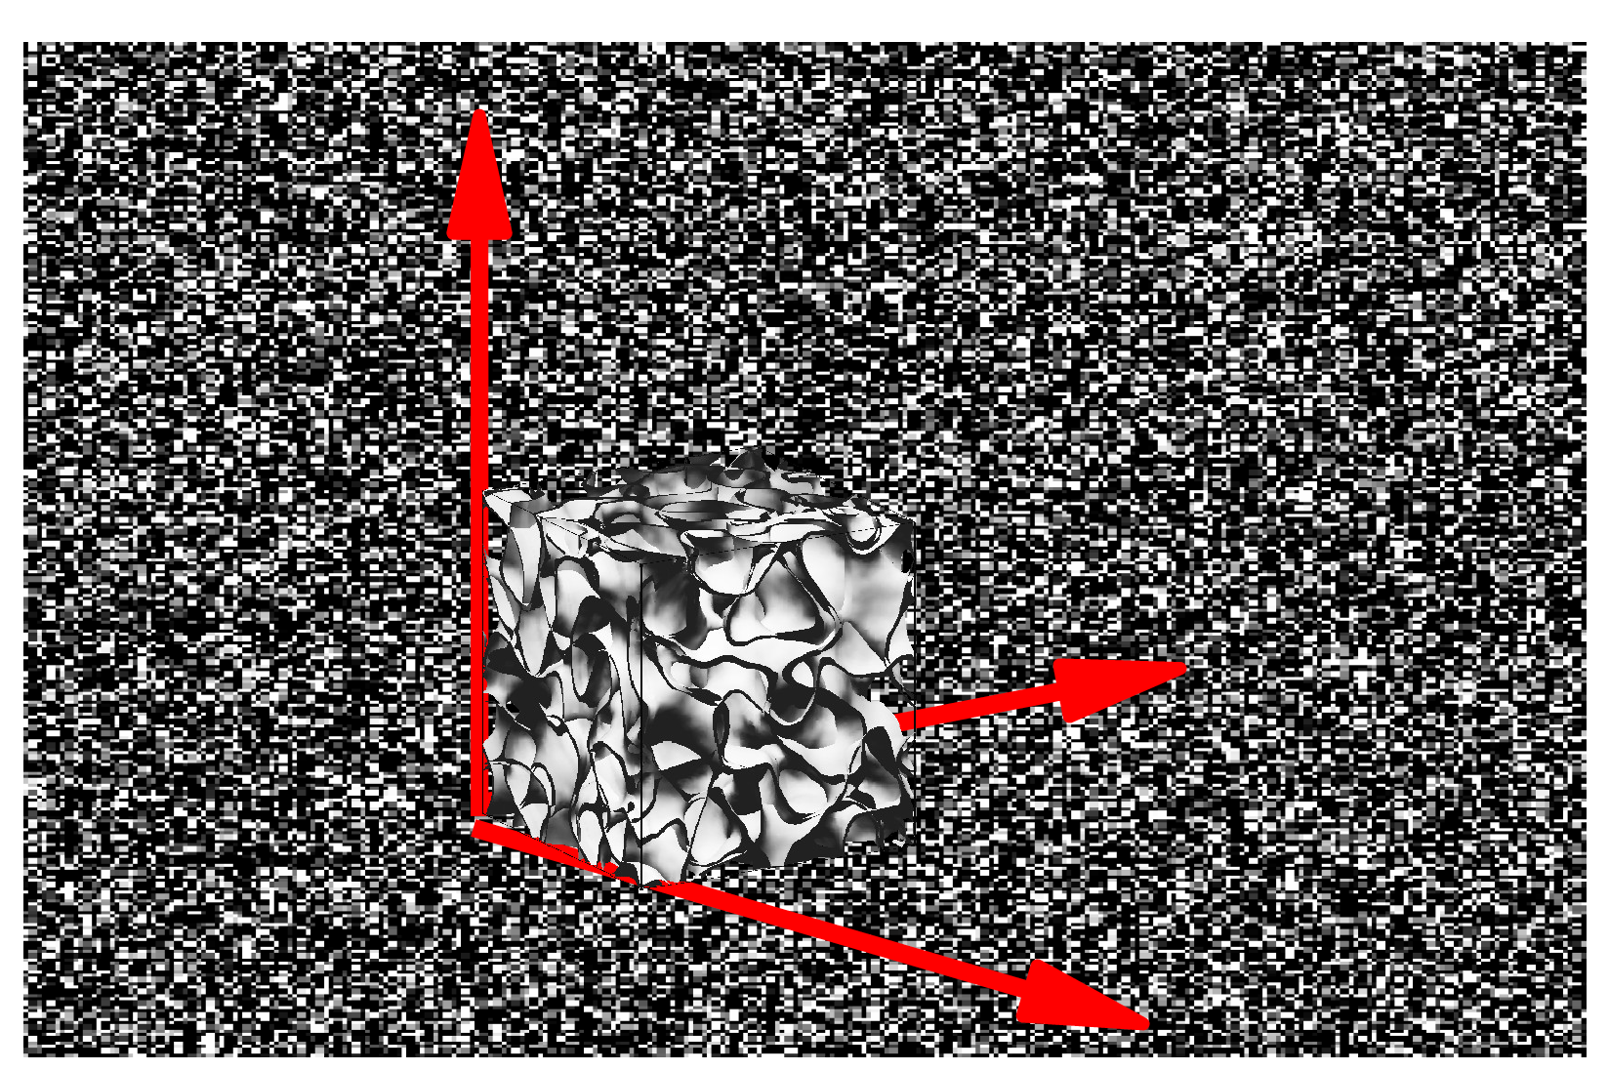
Space of Visual Features: Non Linear

Slide 32
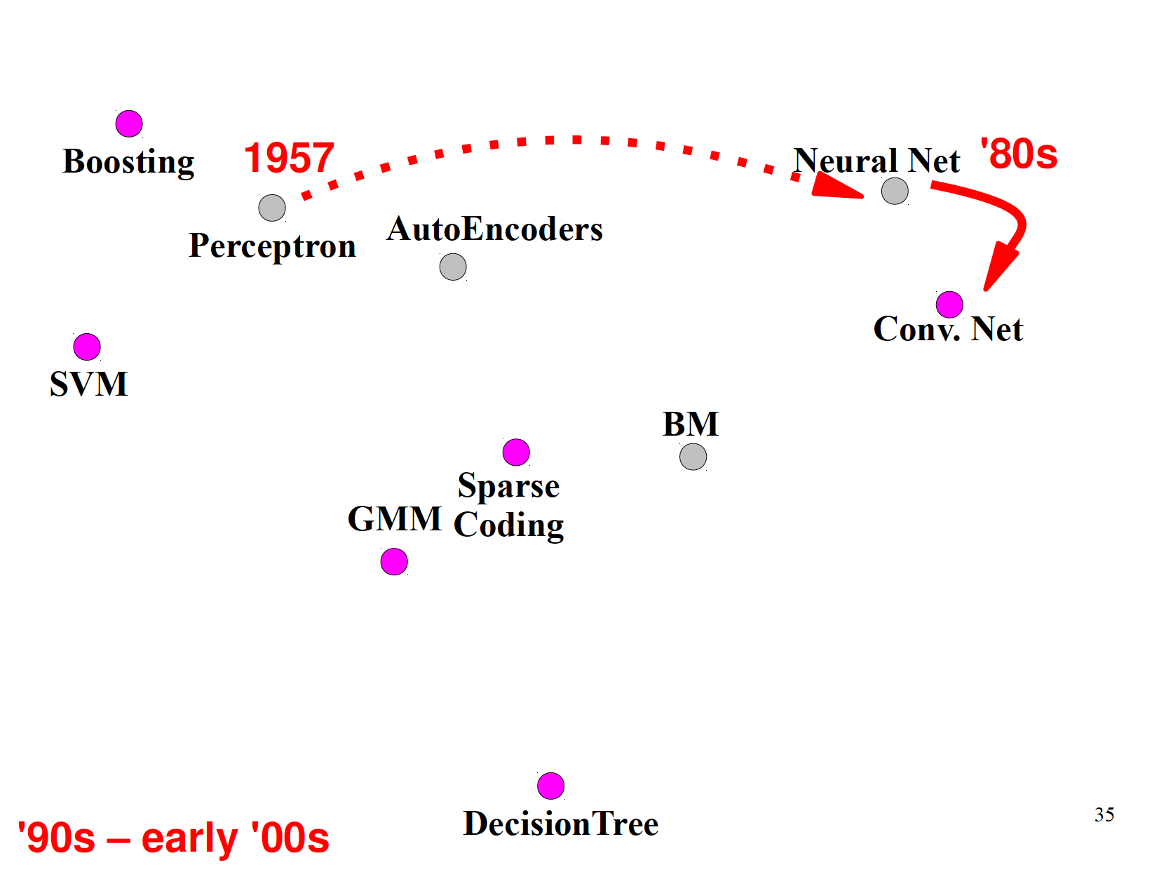

Slide 33
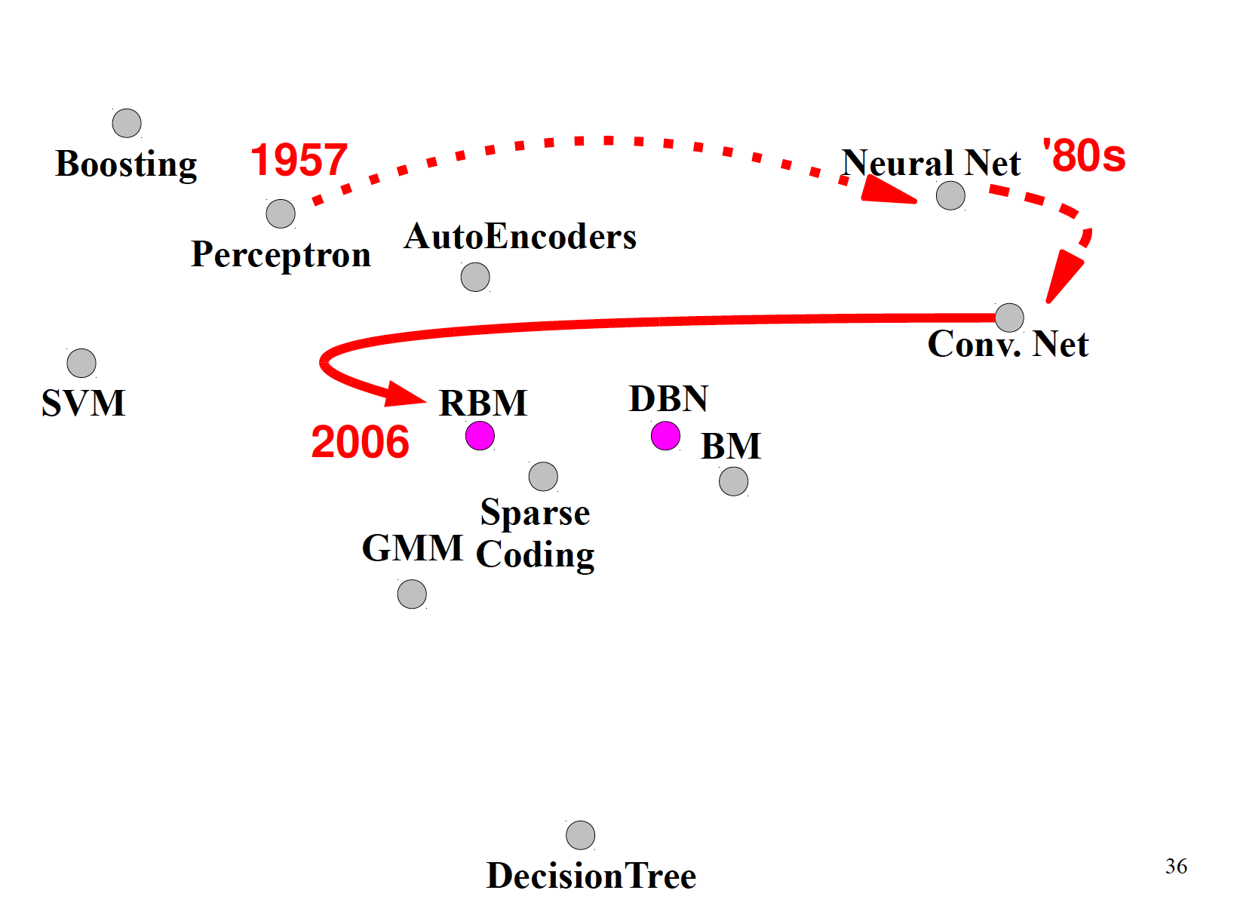

Slide 34
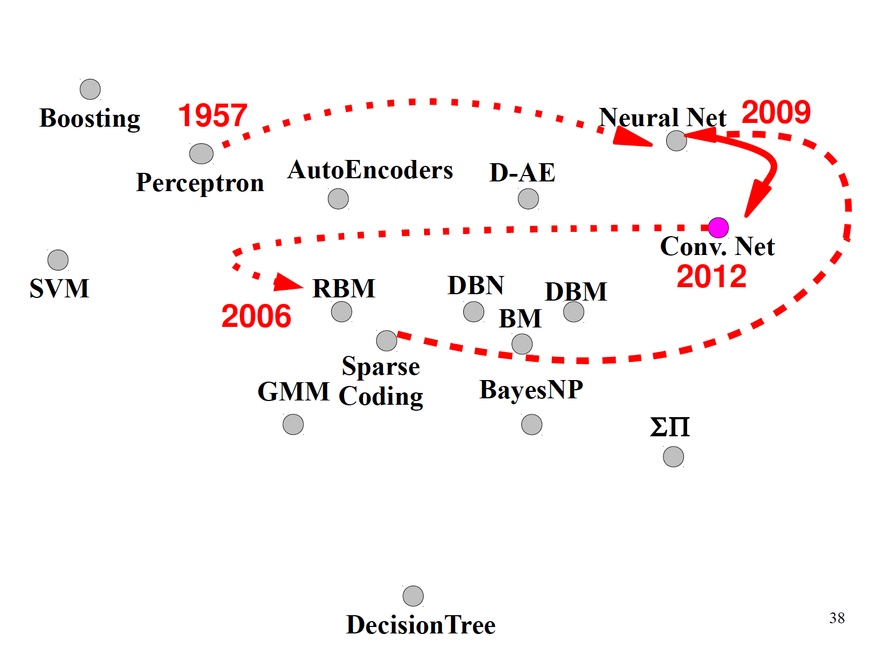

Slide 35
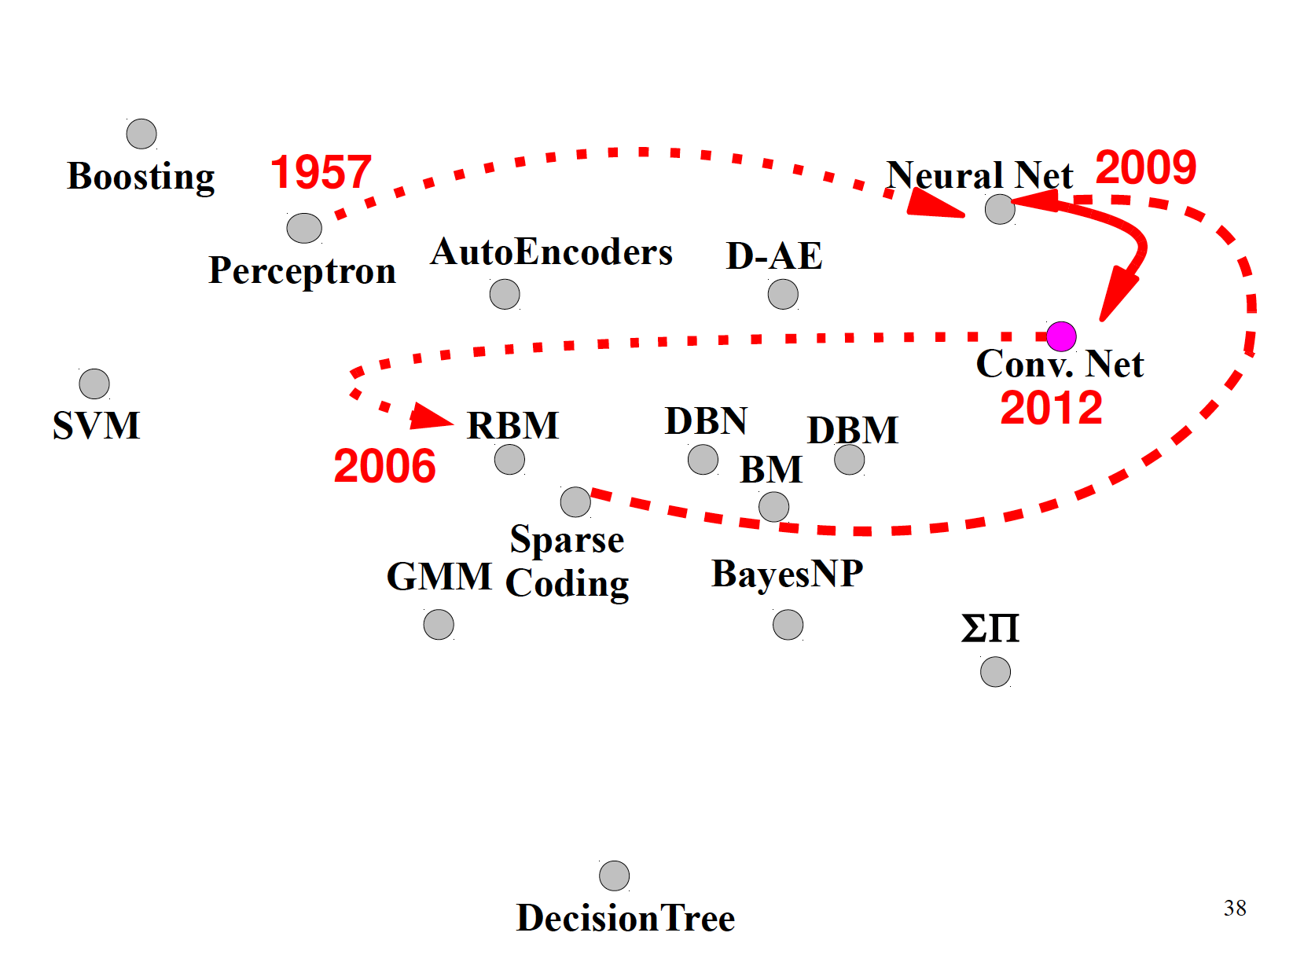

Slide 36
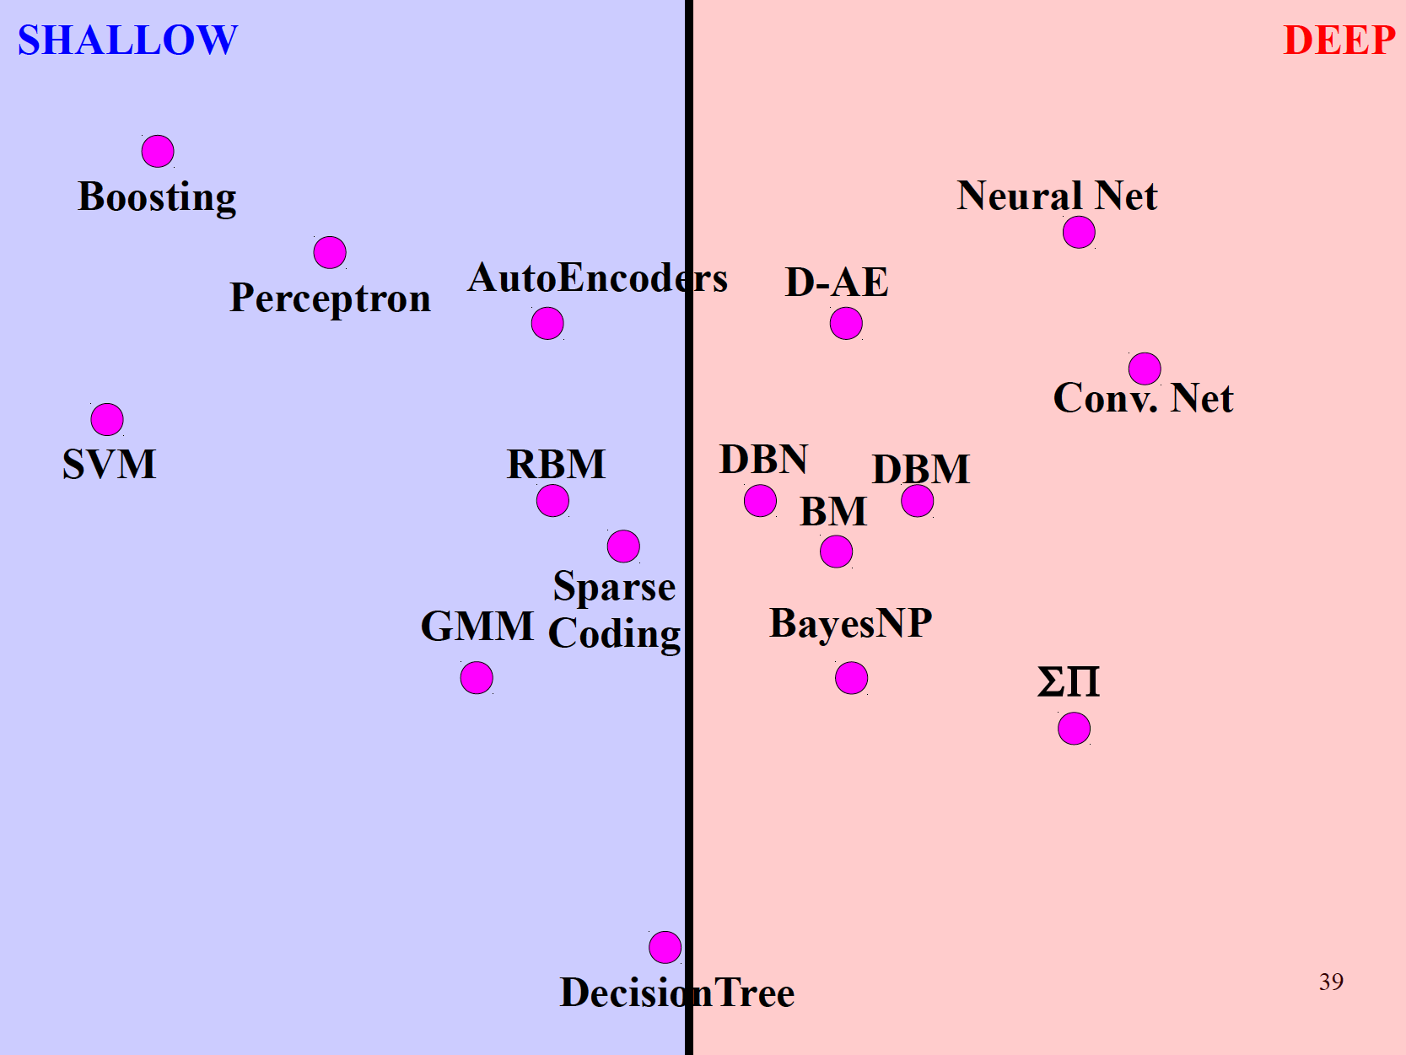

Slide 37
Supervised
Supervised

Slide 38
Convolutional Networks

Slide 46
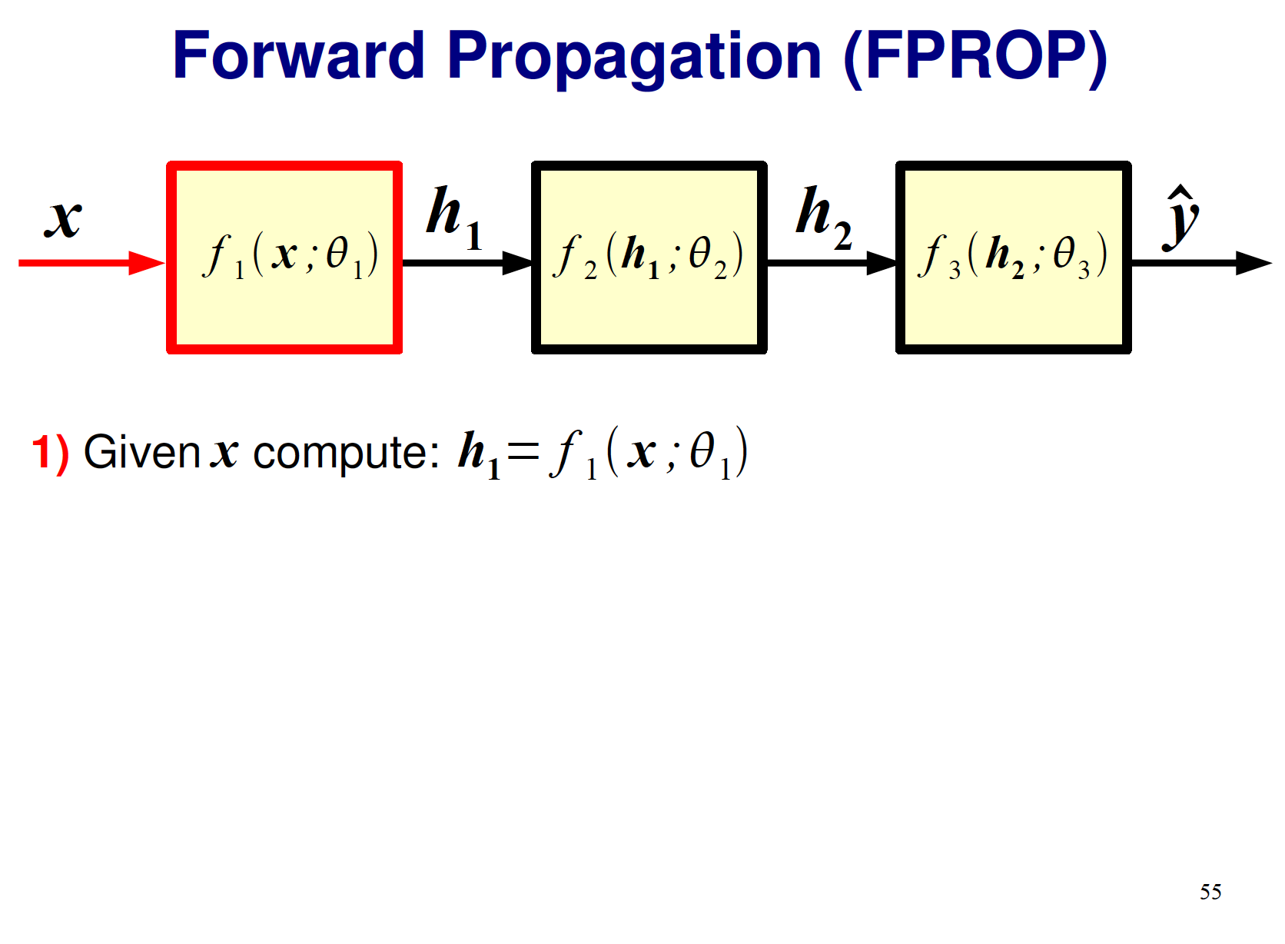

Slide 72
Special Layers
Pooling
Contrast Normalization (No More Used It Seems)

Slide 73
